Slide 1

Recommender Systems: Snapdeal
Snapdeal, a major Indian e-commerce platform, uses a recommender system to personalize shopping experiences. It analyzes user preferences to suggest relevant products, boosting engagement and sales.
JAVVAJI TIRU ESWARA BHUJANGA KUMAR
AP22110010385
CSE-L

Slide 2
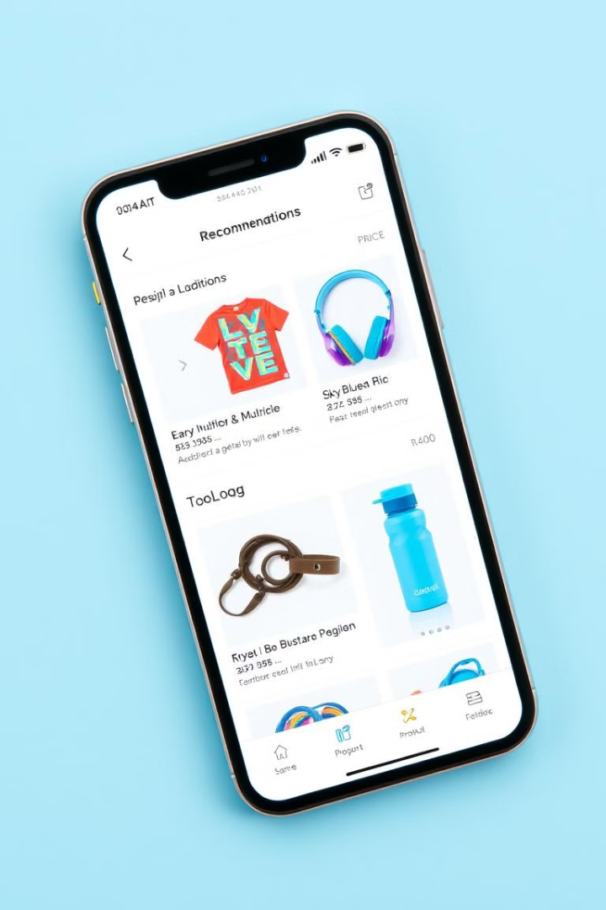



What Are Recommender Systems?
1
Personalization Engines
2
Sales Boosters
They increase revenue by promoting relevant products to potential buyers.
Recommender systems analyze user behavior to provide tailored suggestions.
3
User Experience Enhancers
These systems simplify product discovery, saving time for online shoppers.

Slide 3


Types of Recommender Systems
Content-Based
Collaborative Filtering
Hybrid
Recommends items similar to those a user has liked before.
Suggests items based on preferences of similar users.
Combines multiple approaches for more accurate recommendations.

Slide 4
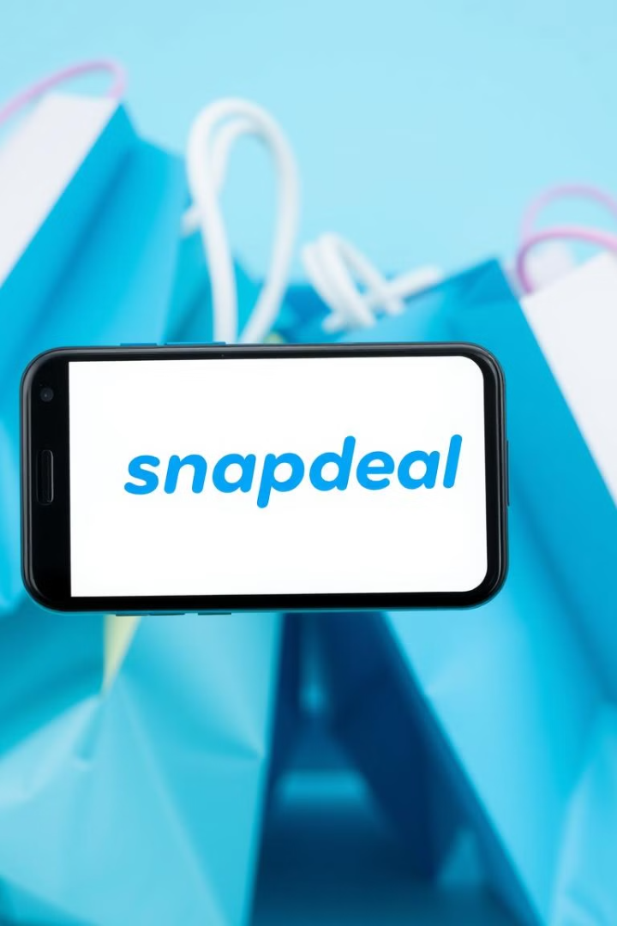
Snapdeal: An E-commerce Giant
Founded
Product Range
Snapdeal was established in 2010, quickly becoming a major Indian e-commerce player.
It offers millions of products across various categories, from electronics to fashion.
User Base
Snapdeal serves millions of customers, necessitating advanced recommendation systems.

Slide 5
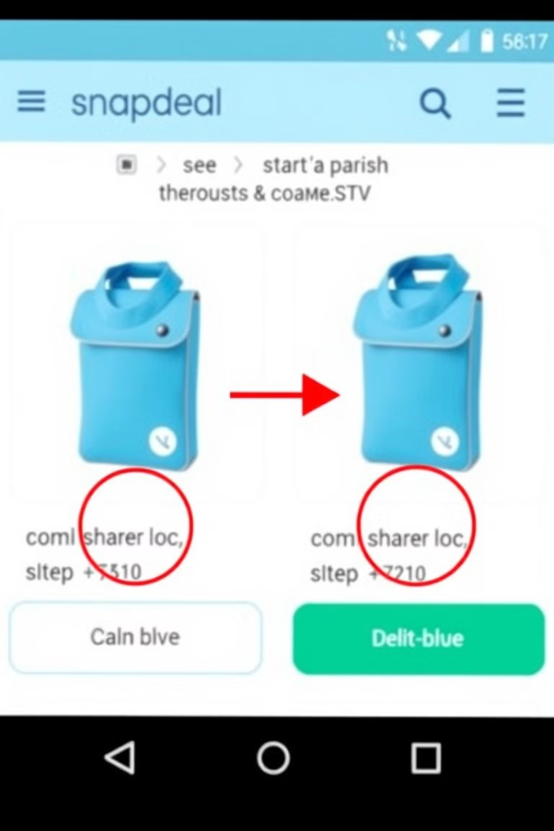


Content-Based Filtering on Snapdeal
1
User Profile Creation
Snapdeal analyzes a user's browsing and purchase history.
2
Item Feature Extraction
Products are tagged with relevant attributes like brand, category and price.
3
Similarity Matching
The system recommends items with features similar to the users preferences.

Slide 6
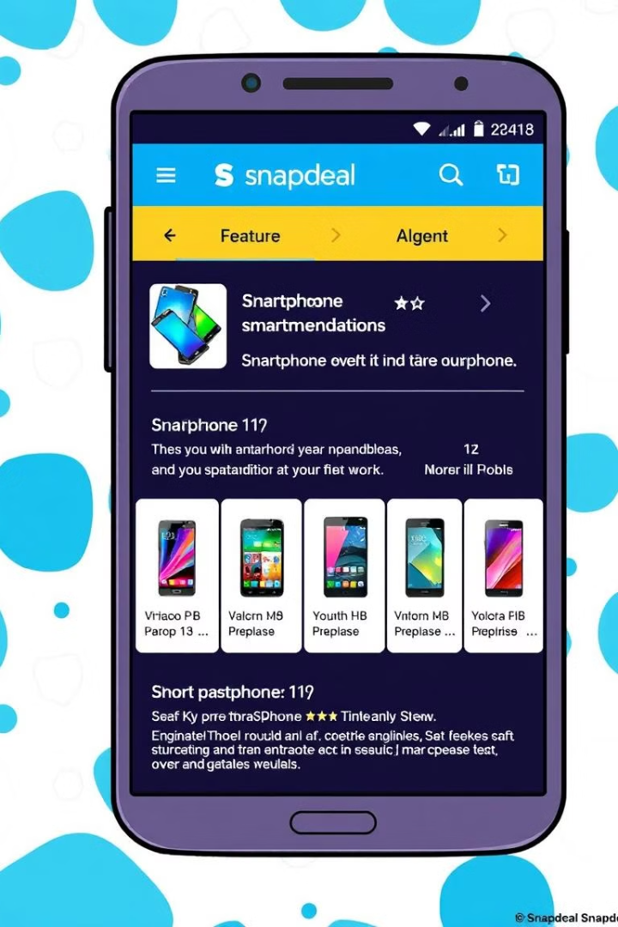



Content-Based Filtering Example
Previous Purchase
User buys a Samsung smartphone on Snapdeal.
Feature Analysis
System identifies key features: brand (Samsung), category (Electronics), price range.
Recommendations
User sees Samsung accessories, similar smartphones, and other electronics in that price range.

Slide 7





Collaborative Filtering on Snapdeal
User Similarity
Purchase Analysis
Recommendation Generation
Snapdeal identifies users with similar shopping patterns.
The system examines what similar users have bought.
Products popular among similar users are suggested.

Slide 8

Collaborative Filtering Example
User A's Cart
Similar User B's Additional Purchase
Recommendation for A
Laptop
Laptop Cooling Pad
Laptop Cooling Pad
Headphones
Bluetooth Speaker
Bluetooth Speaker

Slide 9


Benefits of Recommender Systems for Snapdeal
1
Increased Sales
2
Enhanced User Experience
3
Competitive Advantage
Personalized recommendations lead to higher conversion rates and average order value.
Advanced recommender systems set Snapdeal apart in the crowded e-commerce market.
Customers find relevant products quickly, improving satisfaction and retention.

